Slide 1
Average
Uva 1451, Seoul LA 4726
Time: 3 seconds

Slide 2
Problem Descriptions(1/5)
A DNA sequence consists of four letters, A, C, G, and T. The GC-ratio of a DNA sequence is the number of Cs and Gs of the sequence divided by the length of the sequence.
GC-ratio is important in gene finding because DNA sequences with relatively high GC-ratios might be good candidates for the starting parts of genes.

Slide 3
Problem Descriptions(2/5)
Given a very long DNA sequence, researchers are usually interested in locating a subsequence whose GC-ratio is maximum over all subsequences of the sequence.
Since short subsequences with high GC-ratios are sometimes meaningless in gene finding, a length lower bound is given to ensure that a long subsequence with high GC-ratio could be found.

Slide 4
Problem Descriptions(3/5)
If, in a DNA sequence, a 0 is assigned to every A and T and a 1 to every C and G, the DNA sequence is transformed into a binary sequence of the same length.
GC-ratios in the DNA sequence are now equivalent to averages in the binary sequence.

Slide 5
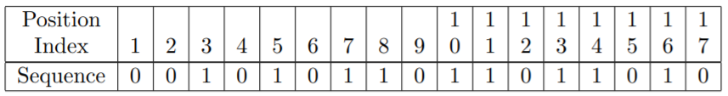
Problem Descriptions(4/5)
For the binary sequence above, if the length lower bound is 7, the maximum average is 6/8 which happens in the subsequence [7,14]. Its length is 8, which is greater than the length lower bound 7.
If the length lower bound is 5, then the subsequence [7,11] gives the maximum average 4/5. The length is 5 which is equal to the length lower bound. For the subsequence [7,11], 7 is its starting index and 11 is its ending index.

Slide 6
Problem Descriptions(5/5)
Given a binary sequence and a length lower bound L, write a program to find a subsequence of the binary sequence whose length is at least L and whose average is maximum over all subsequences of the binary sequence.
If two or more subsequences have the maximum average, then find the shortest one;
If two or more shortest subsequences with the maximum average exist, then find the one with the smallest starting index.

Slide 7
Input
Your program is to read from standard input.
The input consists of T test cases. The number of test cases T is given in the first line of the input.
Each test case starts with a line containing two integers n (1 ≤ n ≤ 100, 000) and L (1 ≤ L ≤ 1, 000) which are the length of a binary sequence and a length lower bound, respectively.
In the next line, a string, binary sequence, of length n is given.

Slide 8
Output
Your program is to write to standard output. Print the starting and ending index of the subsequence.

Slide 9
Sample Input / Output
Number of cases
Start index
End index
2
17 5
00101011011011010
20 4 11100111100111110000
7 11
6 9
n, L

Slide 10
Solution
prefix sum
0 | 0 | 1 | 1 | 2 | 2 | 3 | 4 | 4 | 5 | 6 | 6 | 7 | 8 | 8 | 9 | 9
9
8
7
6
5
4
3
2
1
0

Slide 11
Convex vs Concave
c 好
d₁
c 好
d₂
d₃
a 好
b
c
d₄
a 好
a

Slide 12

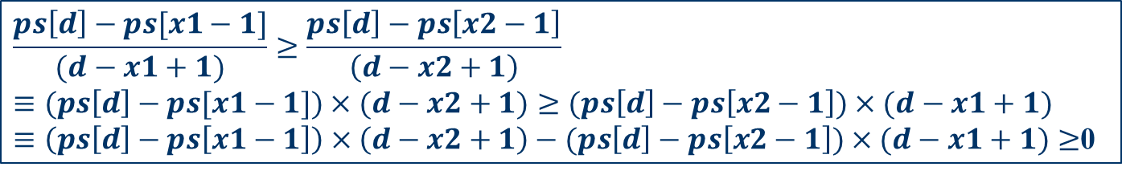


Analysis (找 convex)
convex
concave
$$x1$$
$$x2$$
$$d$$
is_convex
$$\frac{ps\left[d\right]−ps[x1−1]}{(d−x1+1)}≥\frac{ps\left[d\right]−ps\left[x2−1\right]}{\left(d−x2+1\right)}$$
$$≡(ps\left[d\right]−ps[x1−1])×(d−x2+1)≥(ps\left[d\right]−ps\left[x2−1\right])×(d−x1+1)$$
$≡\left(ps\left[d\right]−ps\left[x1−1\right]\right)×\left(d−x2+1\right)−(ps\left[d\right]−ps\left[x2−1\right])×(d−x1+1)≥$0

Slide 13
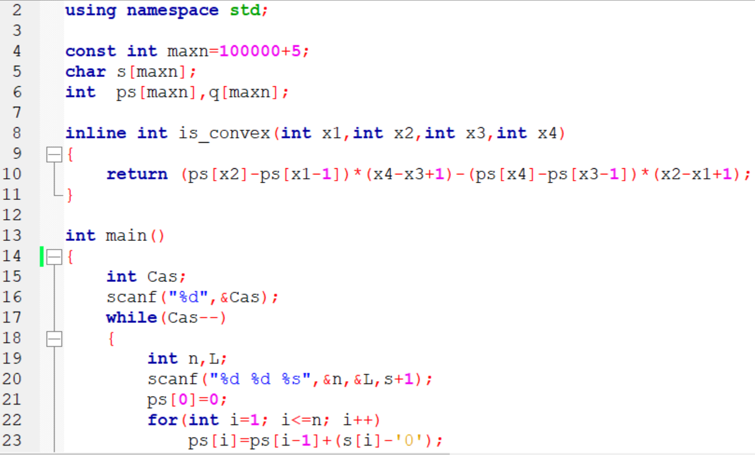

Slide 14
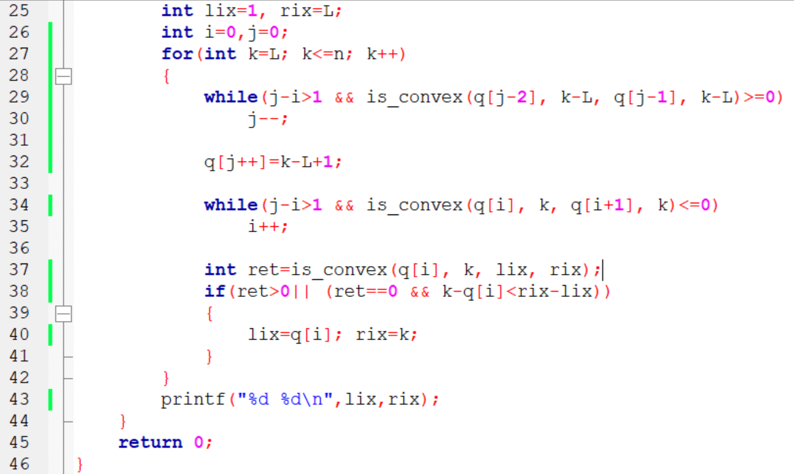
刪除 凸點
將每個點一個一個放入
刪除
第一個凹 點
看是否有更大的斜率

